Slide 1
Types of Maps

Slide 2
Topographic Map :
Topographic map is a type of map characterized by large-scale detail and quantitative representation of relief, usually using contour lines, but historically using a variety of methods
Traditional definitions require a topographic map to show both natural and man-made features
A topographic survey is typically published as a map series, made up of two or more map sheets that combine to form the whole map
Topographic maps are based on topographical surveys
Performed at large scales, these surveys are called topographical in the old sense of topography, showing a variety of elevations and landforms
The first multi-sheet topographic map series of an entire country, the Carte géométrique de la France, was completed in 1789
Topographic surveys were prepared by the military to assist in planning for battle and for defensive emplacements as such, elevation information was of vital importance
As they evolved, topographic map series became a national resource in modern nations in planning infrastructure and resource exploitation

Slide 3
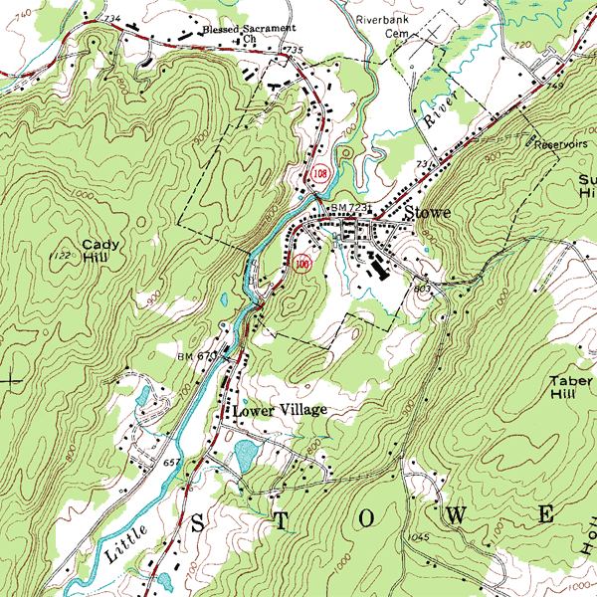
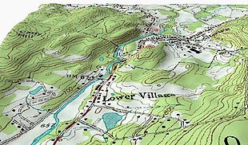
Topographic Maps

Slide 4
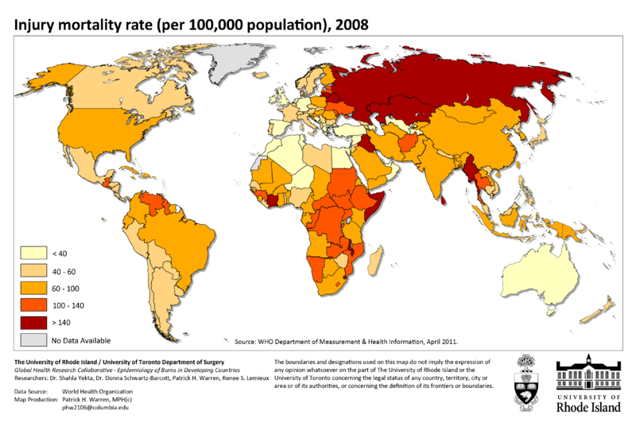
Thematic Map
Thematic map is designed to show the distribution of human or natural features or data
The information may or may not be related to geography
Thematic maps are called so because they show features relating to a particular theme or aspect of geography
John Snow’s cholera map of 1854 is the best known example of using thematic maps for analysis of data

Slide 5
Components of Thematic Maps
1. Primary contents-
Main theme
2. Secondary contents-
Topographic Base map
3. Supportive contents-
Marginal information

Slide 6
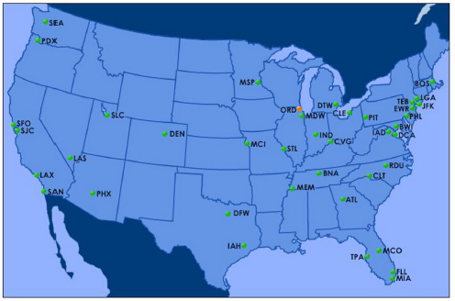
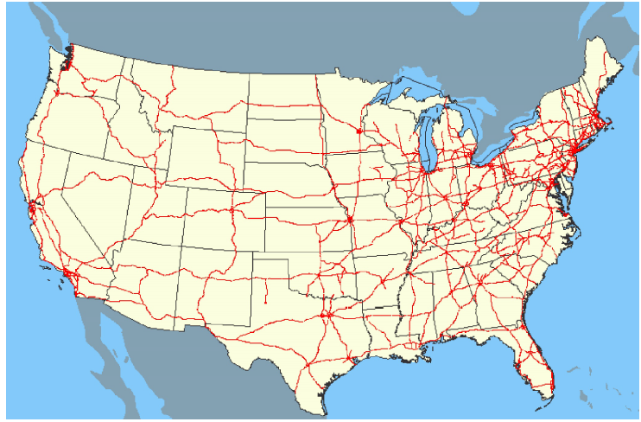
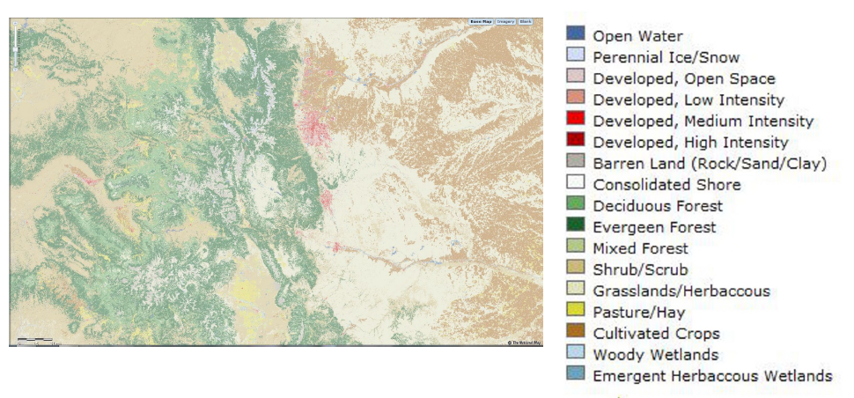
Nominal Map
Line Nominal
Point Nominal
Relates to name or existence of a class
Place names and legends important
Point: labels at locations
Lines: Network shown with symbols
Areas: Classes shown by color and pattern
Simplest data level, no real quantitative analysis possible
Area Nominal

Slide 7
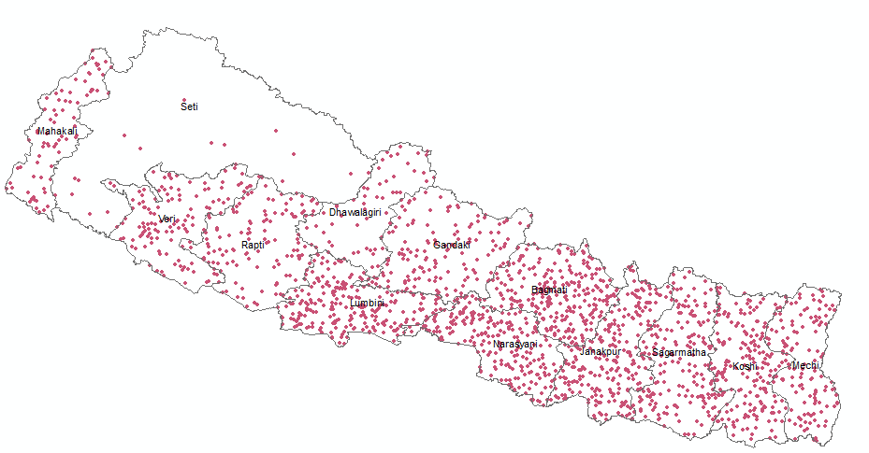
Dot Density Map
A dot distribution map, or dot density map, is a map type that uses a dot symbol to show the presence of a feature or a phenomenon.
Dot maps rely on a visual scatter to show spatial pattern
Main advantages:
easy to understand
best map to show spatial distribution (and density) of discrete features
Disadvantages:
time-consuming / costly
difficult to automate
Dot Map Construction Problem
selection of unit value
determination of dot size
dot location

Slide 8
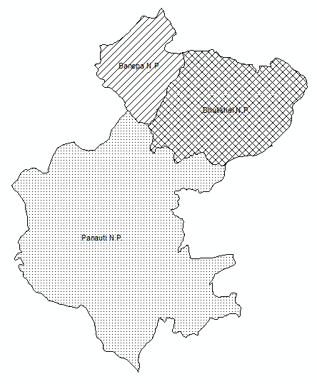
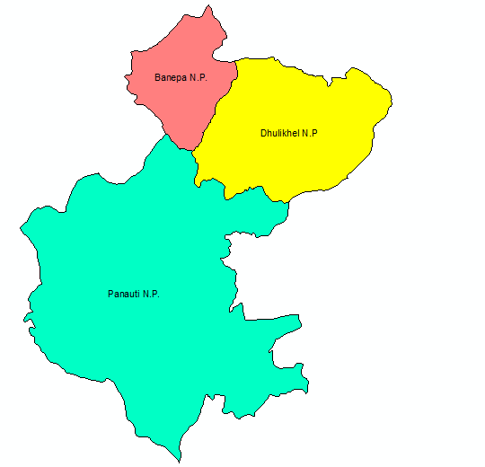
Chorochromatic Map
Greek word Choros: Area Chroma : Color
Shows nominal values for area through different colors
The map readers get impression of nominal, qualitative differences
This type of map can be prepared easily by using different colors or black and white pattern
Special type of chorochromatic map is grid map in which the dominant phenomenon within each grid cell would determine the assignment of a particular color.
Remote Sensing imagery can be taken as a type of (grid) chorochromatic map.
Also called Mosaic Maps

Slide 9
Choropleth Map
Greek words : Choros = area Plethos = Value
Ordinal, interval, relative ratio data in aerial unit can be represented
Values that are used to represent area
The values are calculated for the areas and expressed as a stepped surface, showing a series of discrete values.
As these values are represented through area symbols they can only be relative values.
Generally the darker the grey values, the more intense or the higher the densities of the phenomenon.
Eg: population densities per districts,
percentages of literates in the population by ward etc.

Slide 10
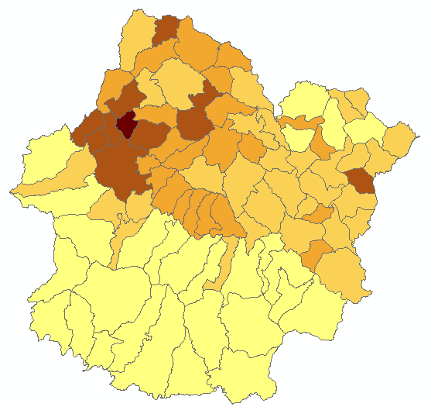
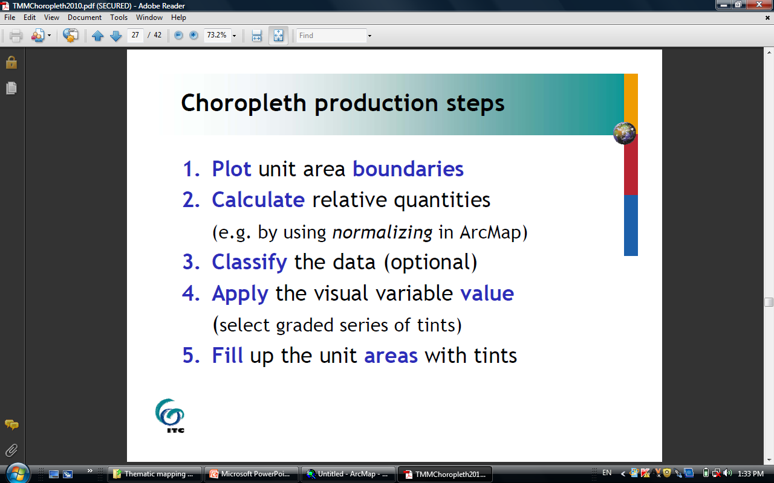
Choropleth Map Production Steps

Slide 11
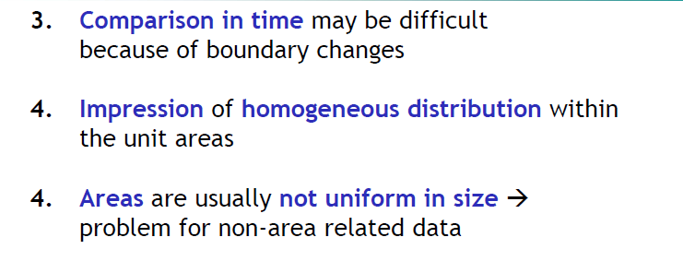
Problems of Choropleth Maps
Application of visual variable values
Effect of data class- difficult to decide class number and breaks of class (natural break, equal etc.)

Slide 12
Geographic phenomena: continuous fields / objects
Continuous fields:
extend over space without interruptions,
gradual changes in field values
e.g. air temperature, barometric pressure, elevation, ...
Discrete fields / objects:
distinguishable individual entities, bounded parts
e.g. land use types, vegetation types, …
Select map type with corresponding impression:
continuous fields : isoline maps
discrete fields/ objects : most other map types

Slide 13
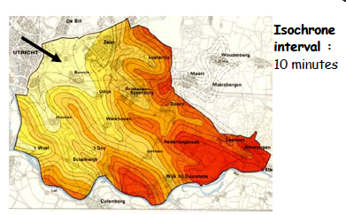
Isopleths maps
combination of a choropleth and an Isoline map, in which the isolines form the boundaries of the areal units
Steps to form isopleth Map
Mapping of data points
Determination of class intervals
Interpolation between the points to create isolines
Shading of zones between the isolines(usually with value)

Slide 14
Isoline Maps
Continuous data (usually at interval or ratio level) are displayed by lines connecting points with equal, representative values in the data set
E.g.: contours : equal elevation
isotherms : equal temperature
isochrones : equal (travelling) time
Continuity can be emphasized by application of the visual variable value (ordered perception property) between the isolines > isopleth map

Slide 15
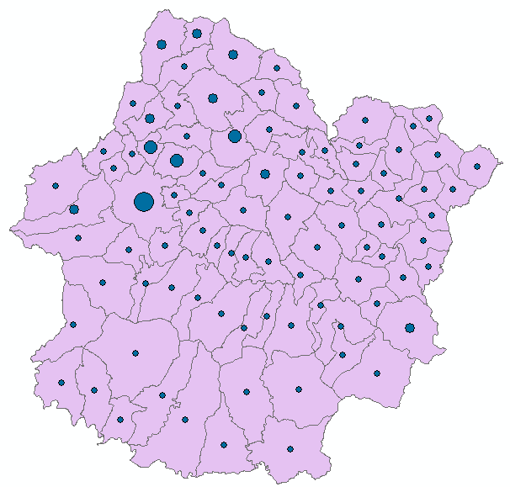
Proportional Symbol Map
Type of thematic map in which absolute quantitative (ratio) point or area data are represented by means of a point symbol the size of which varies with the data values
Range graded
data classified and values represented
by the appropriate mid-class values
(as many symbol sizes as classes)
Graduated
data not classified
(as many symbol sizes as data values)

Slide 16
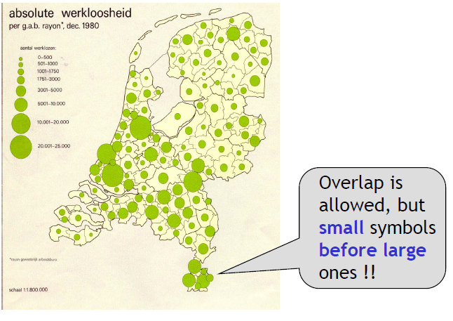
Proportional Symbol: Unit Value
Unit value of proportional circles / squares can be derived after a decision on:
1.the size of the smallest symbol or
2. the size of the largest symbol
or
3. the total area to be occupied by all symbols together (10-15% of map area)

Slide 17
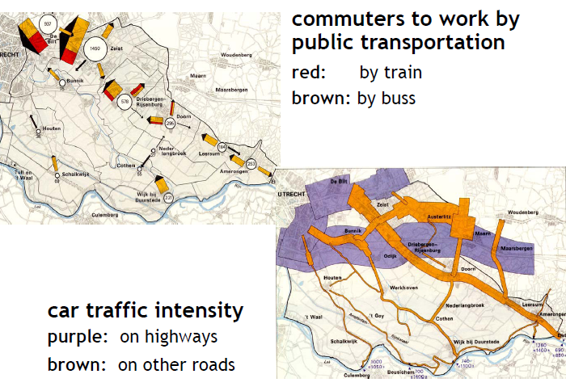
Flowline Map
thematic map type in which directions and/or routes of movement are represented by lines / arrows of varying widths
the width of each line / arrow is proportional to the statistical value of the movement along it (e.g. number of vehicles, volume of freight, monetary value of trade)
application of the visual variable size to represent absolute ratio data

Slide 18
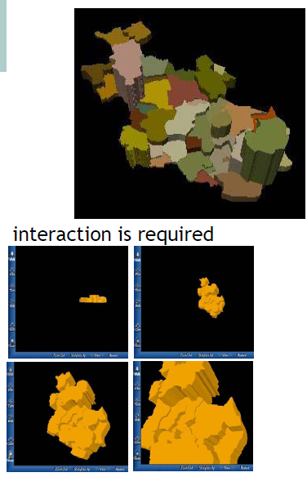
Prism Maps
A Prism Map is a 3d map that uses color and height to indicate a single value data field.
These are often considered as Themes, but Prism Maps are plotted in their own window and do not auto-update when the underlying data changes.
Areas are represented as elevated spatial units (2.5 / 3D) or prisms
Elevation is proportional to the data values: absolute ratio data, aggregated over areas

Slide 19
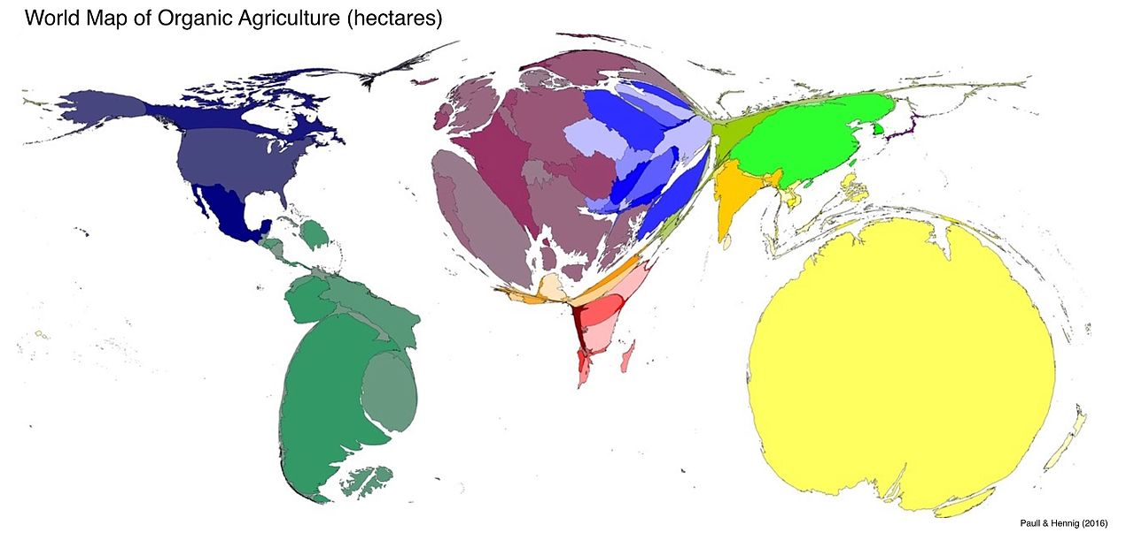
Cartograms
A cartogram is a map in which some thematic mapping variable – such as travel time, population, or GNP– is substituted for land area or distance.
The geometry or space of the map is distorted, sometimes extremely, in order to convey the information of this alternate variable.
They are primarily used to display emphasis and for analysis as nomographs.
Two common types of cartograms are area and distance cartograms

Slide 20
Thank You

